Slide 1
SUMMER TRAINING PROJECT SOCIAL MEDIA RESUME GENERATOR

Slide 2
PRESENTED BY:
NITIKA RAWAT,
TANIYA PAWAR,
SNEHA CHOUDHARY,
MERIN MARY JAIN.

Slide 3
Table of contents
1.
4.
2.
5.
3.
6.
Abstract
Working of Project
Introduction
Conclusion
Diagrams
Future Scope

Slide 4

01
ABSTRACT

Slide 5
ABSTRACT
In a world full of the internet, everyone is nowadays engaged socially
through many social media platforms. Be it be Facebook and Instagram and so on.so we came up with the idea of creating a project called Social Media Resume Generator.
Our project's main aim was to create the social media resume of the user, which contains direct links to the profiles of the user, who is active in some majorly used social media platforms.
Our project takes the user details and generates the resume. It creates username key that is shared with people to invite them to your social media platform.
This Python GUI-based project was created using the PyCharm IDE platform. The GUI elements were designed using TKINTER python and the back end was designed using PYTHON and SQLite.

Slide 6
02
INTRODUCTION

Slide 7

INTRODUCTION
The proposed system is a User Interacting Platform System created using Python programming language is platform from where the users can connect and share their social information with others. Platform provides the idea of social life and links to social media accounts of the user i.e. major social media platforms in which user is active, they can connect with different type of people on different platform since each user shares the Username.
This system provides communication so that users can share their thoughts without zero delay issues. This is small platform or application created using Python and its Modules which Generate resume compiling personal details and links to majorly used social media accounts. This platform helps you to with the people’s social life.

Slide 8
ADVANTAGES FOR USERS:
User can easily create the resume.
Instead of mentioning and sharing username from different platform the person can share this resume username.
Thus, saves a lot of time.
ADVANTAGES FOR ADMIN:
Admin can manage all users.
Admin can make any changes to the website.
Admin can manage or modify.
TOOL AND PLATFORM
GUI: TKINTER
Tkinter is the most commonly used library for developing GUI (Graphical User Interface) in Python. It is a standard Python interface to the Tk GUI toolkit shipped with Python.
PROGRAMMING LANGUAGE: PYTHON
Python is a widely used general-purpose, high level programming language. With its emerging popularity python is become more common among developers and almost all new applications comprises of python since its easy to use deploy and manage.

Slide 9
DATABASE CONNECTIVITY: SQLITE
SQLite is a software library that implements a self-contained, server less, zero- configuration, transactional SQL database engine. The source code for SQLite is in the public domain.
SQLite3 can be integrated with Python using sqlite3 module DB Browser for SQLite DB Browser for SQLite is a free and open-source tool to interact with SQLite databases with a graphical interface. You can use the software to view and edit database files.
SYSTEM REQUIREMENT
HARDWARE REQUIREMENTS:
Processor: Intel (R) core (TM) i3 (recommended) and advance.
RAM: 2GB (minimum required) and advance.
Screen Resolution: 1600x900 recommended.
SOFTWARE REQUIREMENTS:
Operating System: 32 bit based OS (minimum required) and advance.
Windows 8 minimum required and advance.
Programming language: Python 3.8.10 preferred (Preinstalled).
Programming IDE: PyCharm IDE.
Python third party modules required: OpenCV, urllib3, Pillow.

Slide 10
03
DIAGRAMS

Slide 11
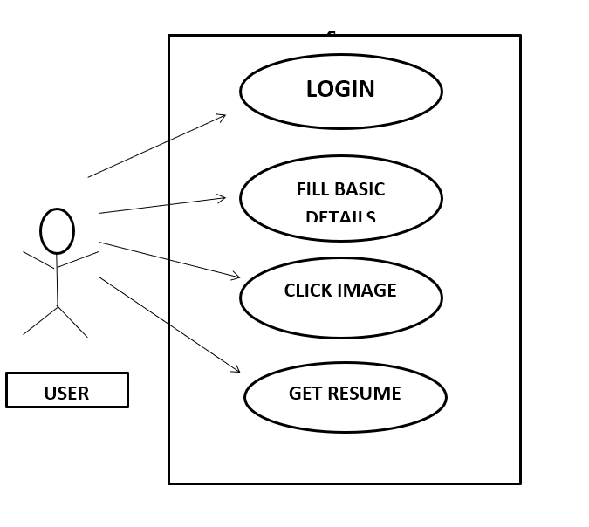
USE CASE DIAGRAM

Slide 12
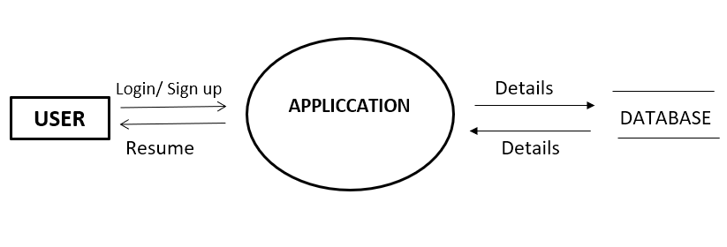
DFD LEVEL - 0

Slide 13
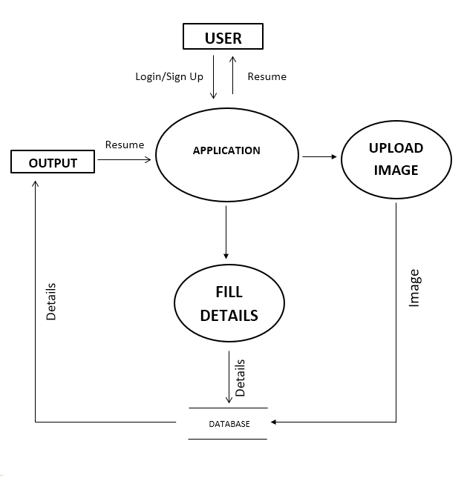
DFD LEVEL - 1

Slide 14
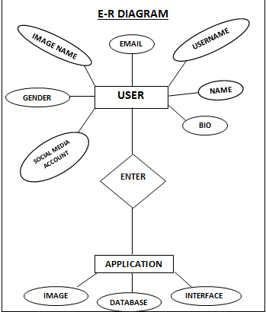
E-R DIAGRAM

Slide 15

03
Working of Project

Slide 16
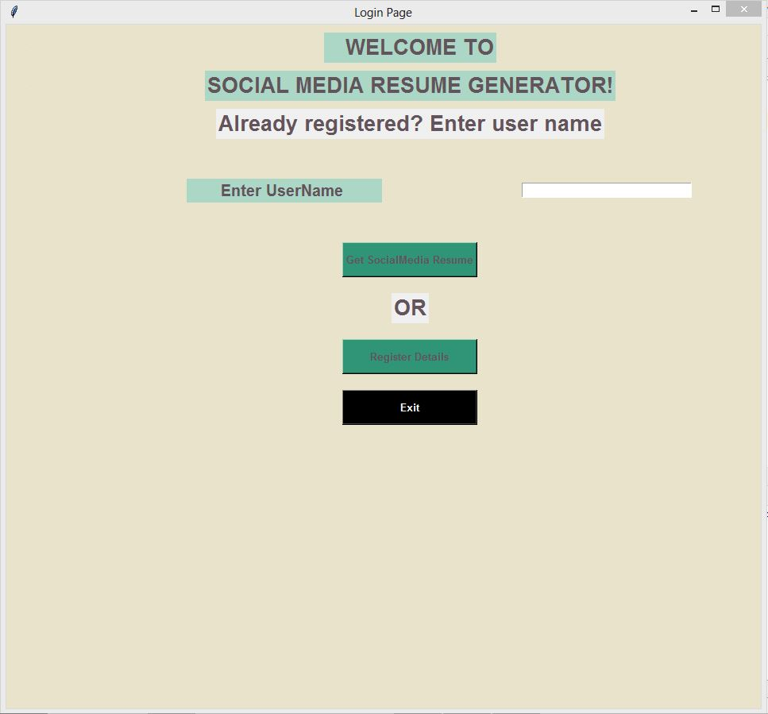
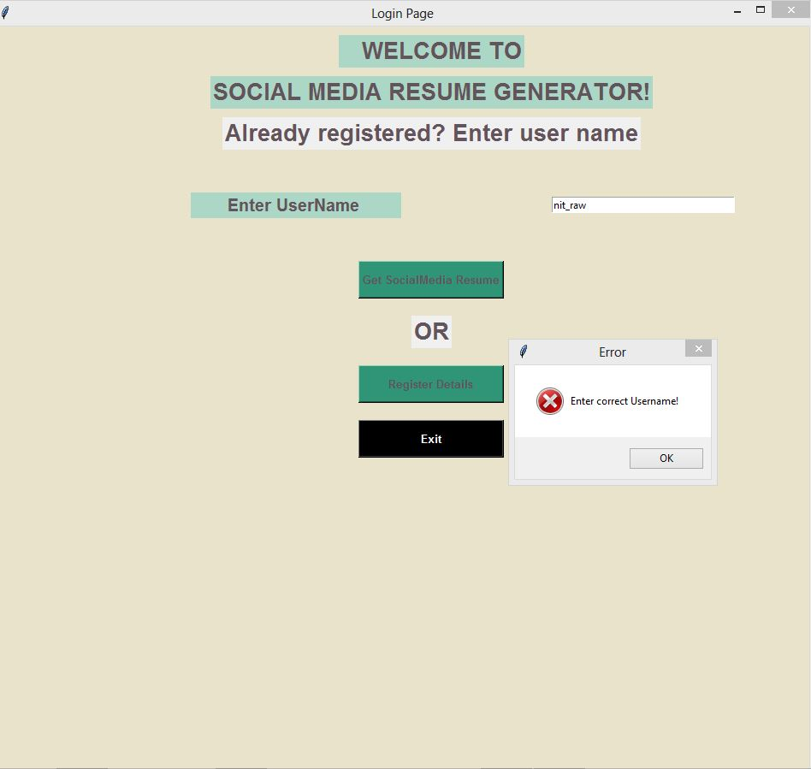
*Login Page
Here first user entered a username but since username is not registered in database it will show error message informing user that its not registered i.e user name is not correct. or user might be entering a wrong username.

Slide 17
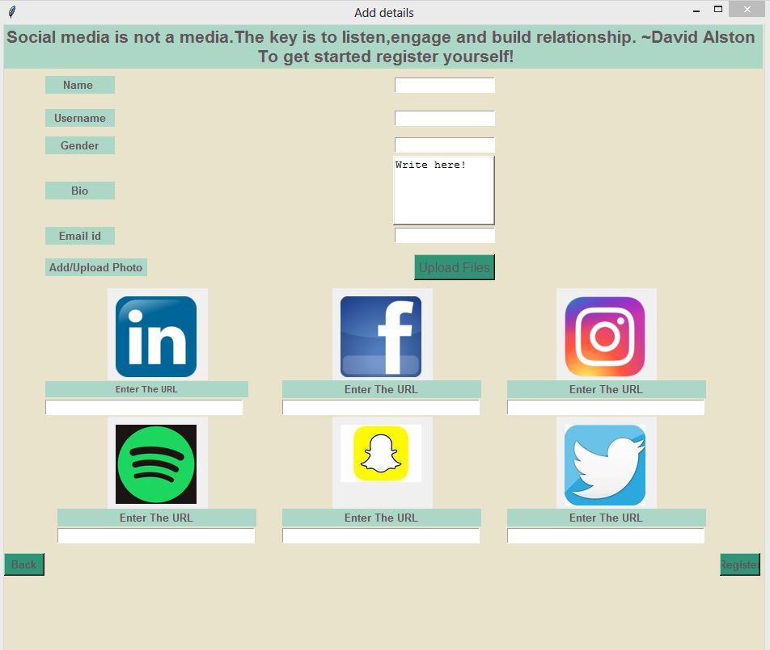
*ADD DETAILS(Register)
To capture image
Add profile links to following social media platform
Button to generate your social media resume(When all required information is entered by user).
Button to go back to login page
When clicked on register detailed button(Login page), Add details Page will be opened to add details for registering user and generate user’s social media resume from those details.

Slide 18
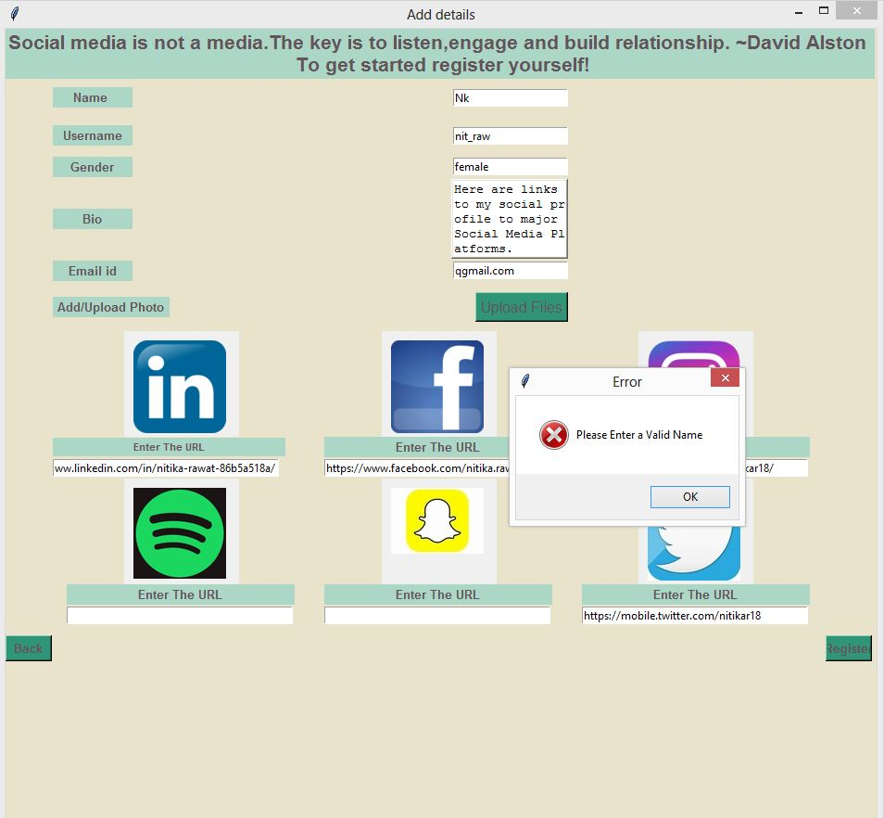
Name length should be 3 minimum otherwise it will show message

Slide 19
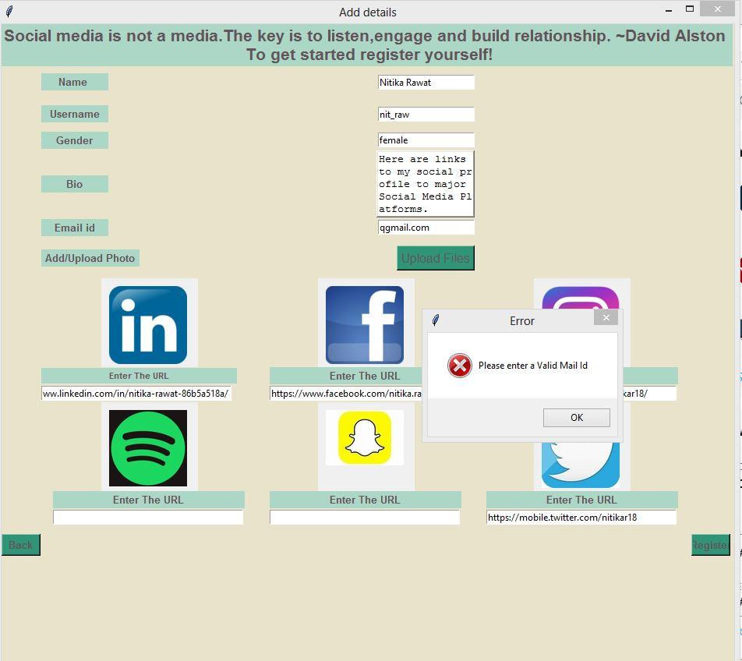
Enter a valid Email-id with @ in it otherwise and message will display you saying you enter invalid email

Slide 20
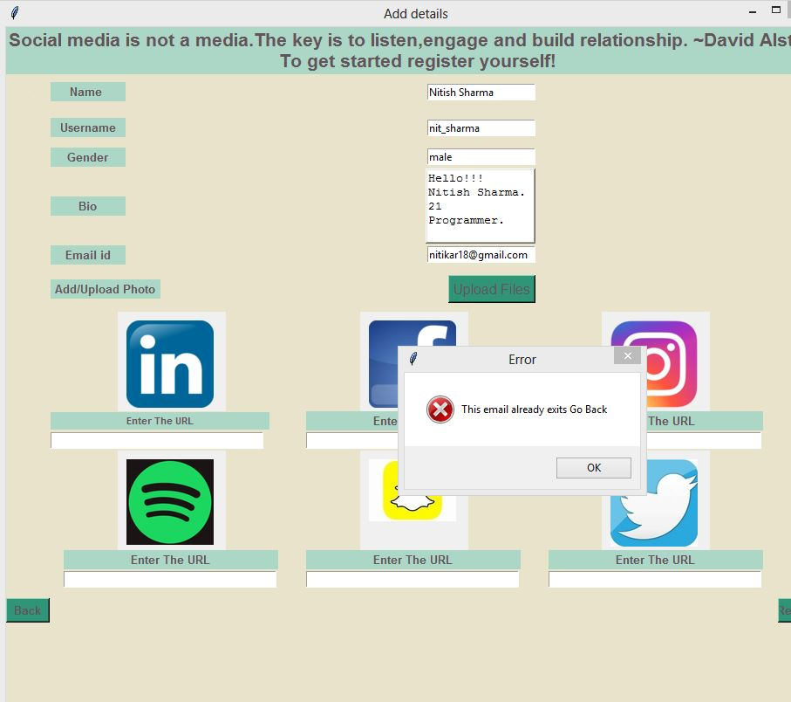
Exception generated if Email-id already exists, leading you to Login page where you can enter user name and directly view your Social Media Resume

Slide 21
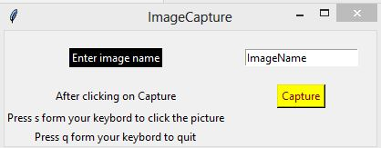
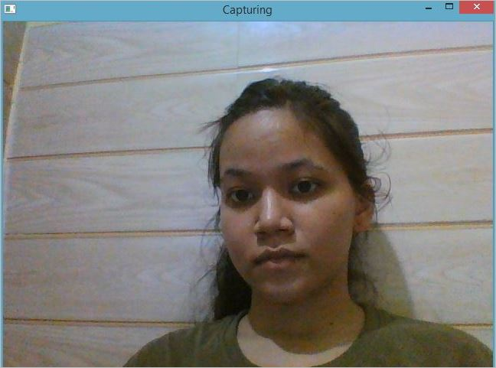

*UPLOAD IMAGE
<<<<<<<<<<<<
Click on upload image to Capture image then a tkinter window will open.
Enter name for your image and click on Capture
>>>>>>>>>>>>>
Capturing tkinter window will open to capture your image through webcam.
Press s to click photo then.
And q to quit.

Slide 22
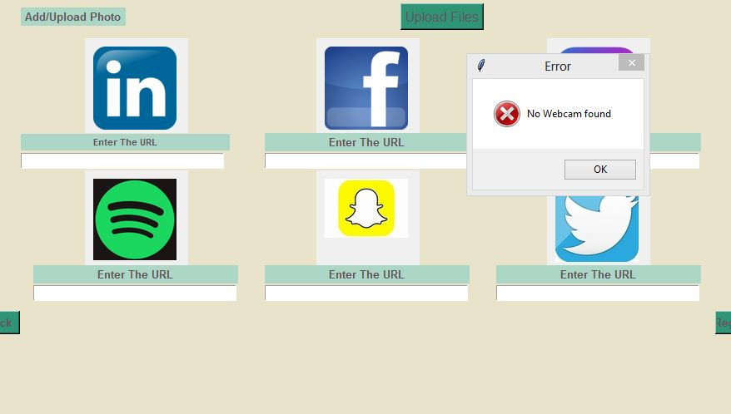

**if no webcam available default img is set for profile pic.
default image

Slide 23
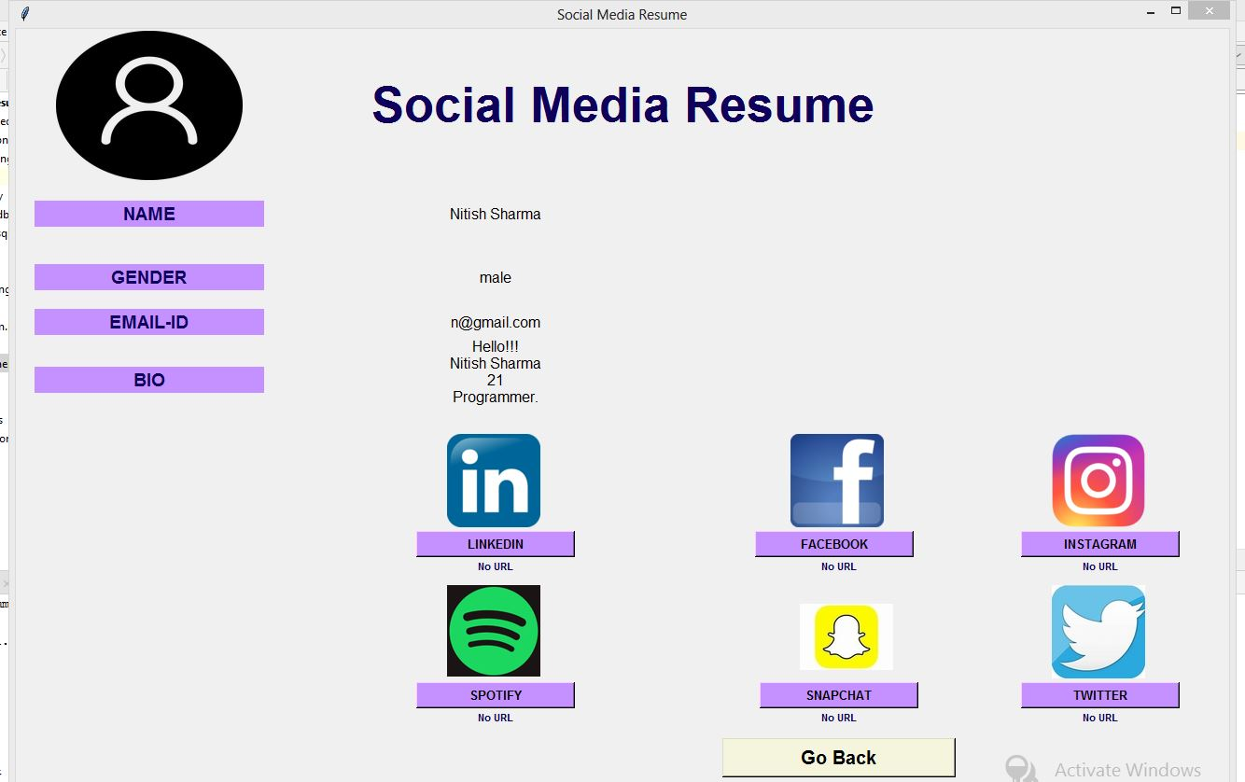
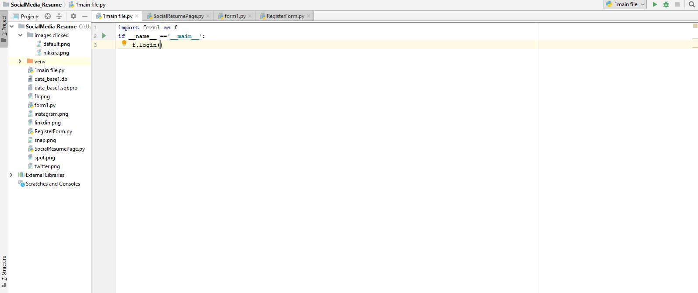
<<<<<<<<<<<<<<<<Setting Default image in case no webcam found.
>>>>>>>>>>>>>>>>>>>
Image saved in folder Image-clicked that is in the same directory

Slide 24
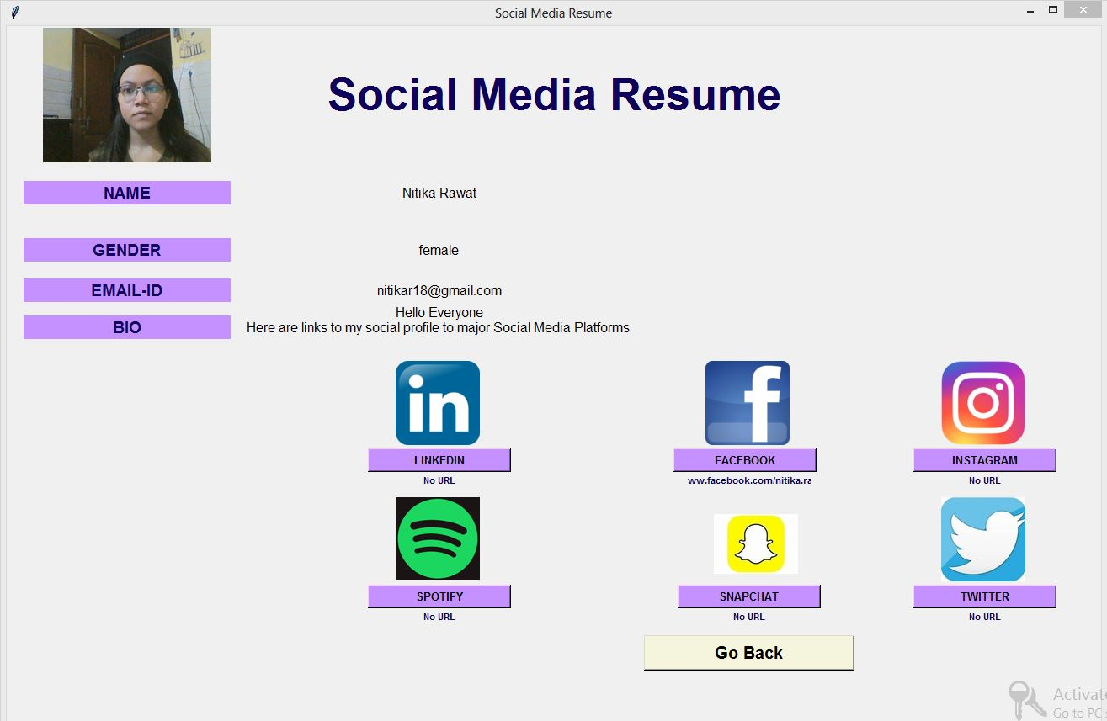
*SOCIAL MEDIA RESUME
User image that was clicked
click on button to visit given profile link
Button to go to link
when no URL is given No URL is written
Go back button to go back to main login page

Slide 25
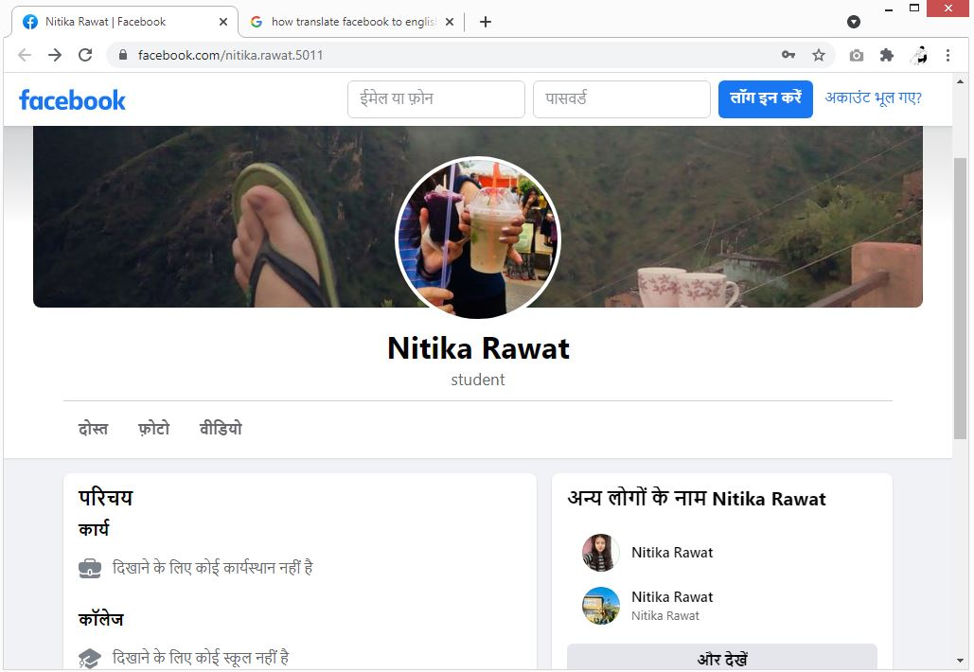
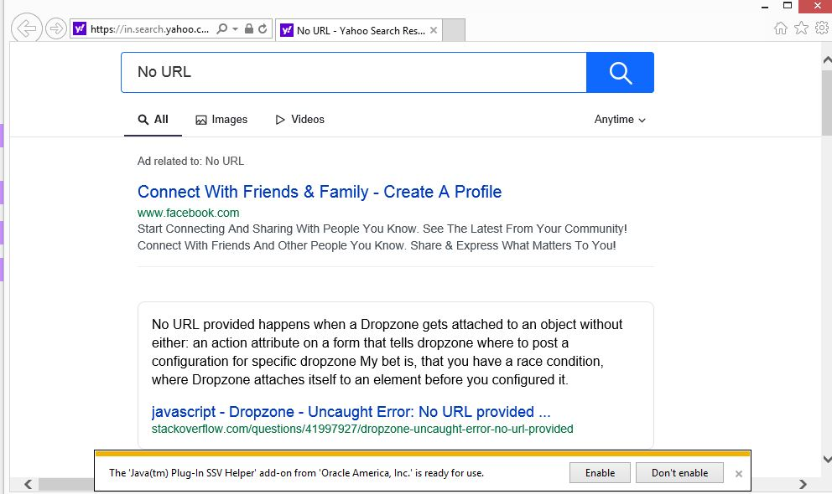
When clicked on button containing link to Facebook profile
If no URL passed

Slide 26
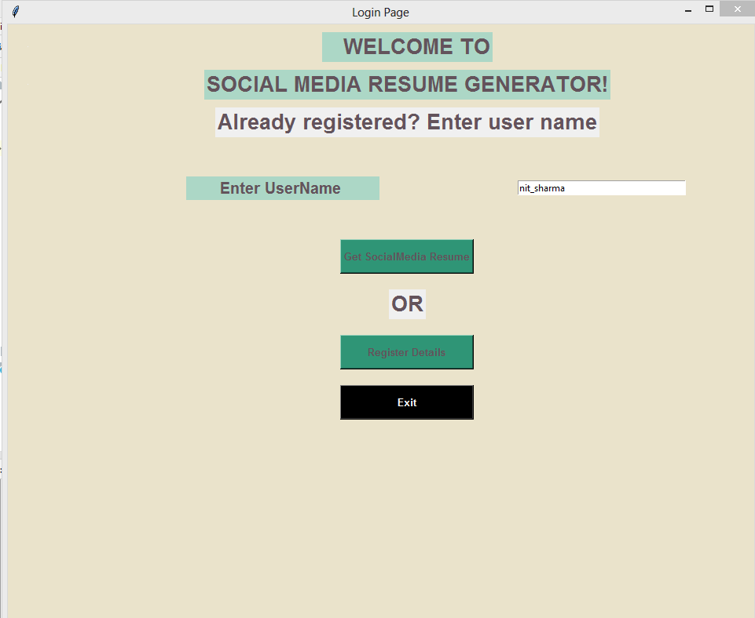
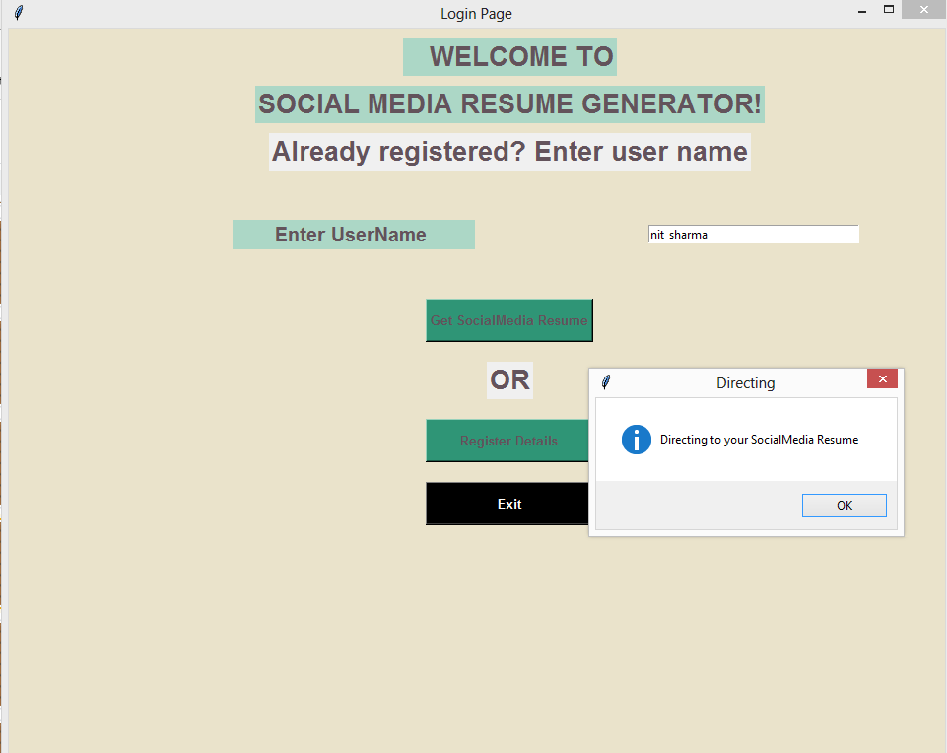
*Enter Your username to directly view your resume
when clicked
Get Social Media Resume

Slide 27
**Your resume will appear

Slide 28
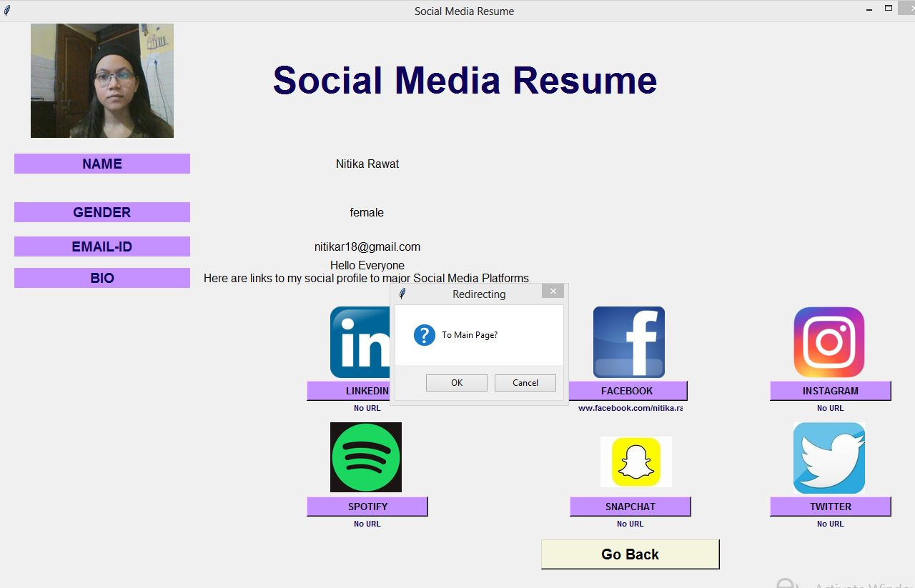
<<<<<<<<<< Go back to Main page

Slide 29
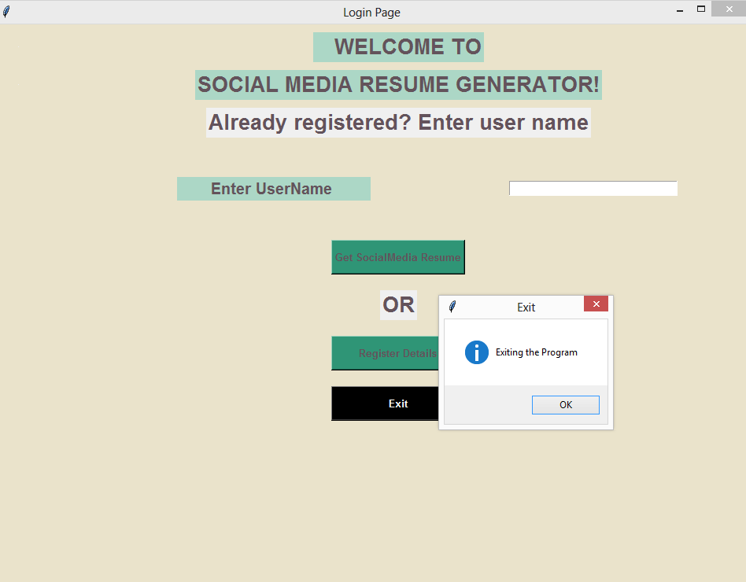
*Exit Program
Exit the Program

Slide 30
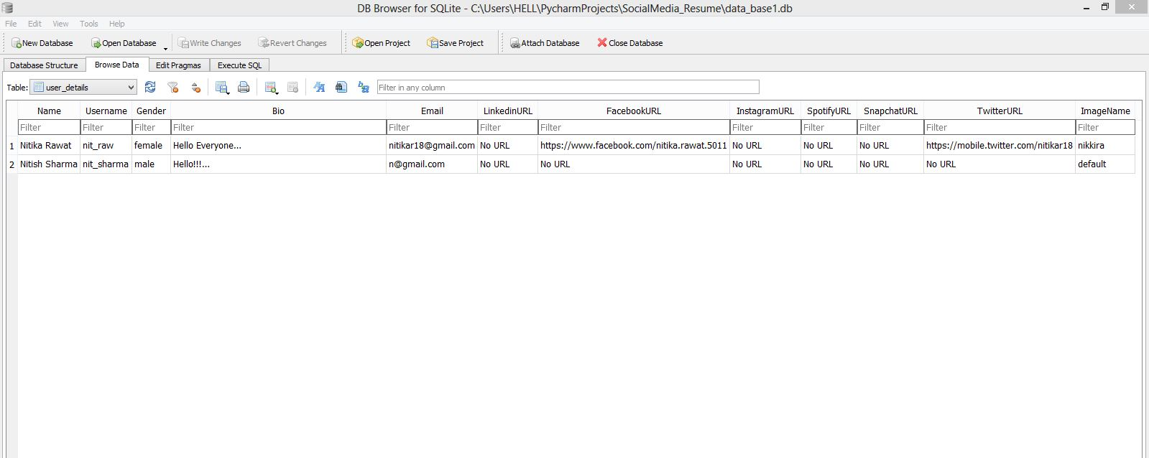
DB Browser SQLite
*Database

Slide 31
05
CONCLUSION

Slide 32
Conclusion
In a nutshell, the project SOCIAL MEDIA RESUME GENERATOR helps users generate resumes of their social media life.
Here all the users can share their social resumes by sharing the username with new people
they meet.
Using that username person can go to that user's social media profiles of some major social media platforms and start following them.
In this project, we have used various python modules, libraries, and packages like Tkinter, Web-browser, sqlite3, cv2, PIL, util, etc.
In today's life, people's interactions are everything and nowadays majorly interactions are made through social media platforms or any other online platform.
So, keeping in mind the importance of social media platforms in our user's life we tried creating our project SOCIAL MEDIA RESUME GENERATOR.

Slide 33
06
FUTURE SCOPE

Slide 34
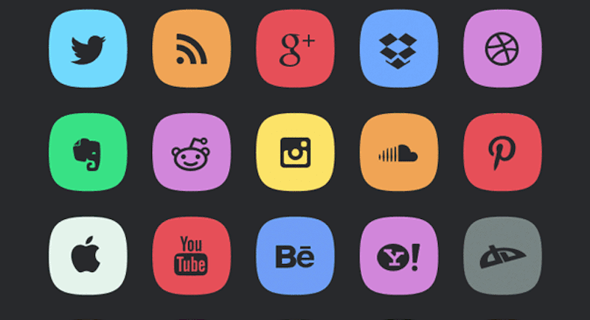
FUTURE SCOPE
Web Based Application with more interactive UI and UX.
Resume download option.
Resume shareable link.
User ID/ Username and Password login.
Resume appreciation / Like Button.
More security and assurance.

Slide 35
Thank You

